Slide 1
Software Process
Software Process
Software process is the framework for the activities, action, and tasks that are required to build high quality software.

Slide 2

Process Flow
A linear process flow executes each of the five framework activities in sequence, beginning with communication and culminating with deployment.

Slide 3
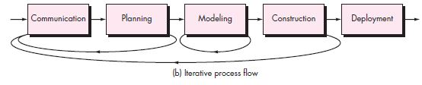
Process Flow
An iterative process flow repeats one or more of the activities before proceeding to the next.

Slide 4
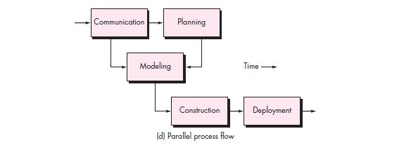
Process Flow
A parallel process flow executes one or more activities in parallel with other activities.

Slide 5
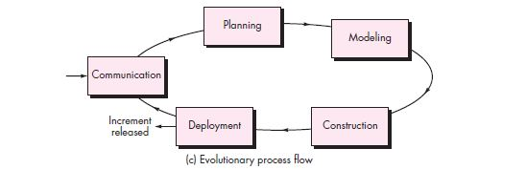
Process Flow
An evolutionary process flow executes the activities in a “circular” manner.

Slide 6
Process Flow

Slide 7
Process Model
Waterfall Model (Linear Model)
Incremental Process Model
Evolutionary Process Model (Prototyping, The Spiral)
Rapid Application Model (RAD)
Agile Process
Unified Process

Slide 8
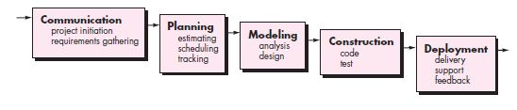
Process Model
Waterfall Model

Slide 9
Advantages of waterfall model
This model is simple and easy to understand and use.
It is easy to manage due to the rigidity of the model – each phase has specific deliverables and a review process.

Slide 10
Disadvantage
Once an application is in the testing stage, it is very difficult to go back and change something that was not well-thought out in the concept stage.
Not suitable for the projects where requirements are at a moderate to high risk of changing.

Slide 11
Waterfall Model
The waterfall model is the oldest paradigm for software engineering
When to use Waterfall model?
Requirement are very well known
Production definition is stable
Technology is understood
New version of existing product

Slide 12
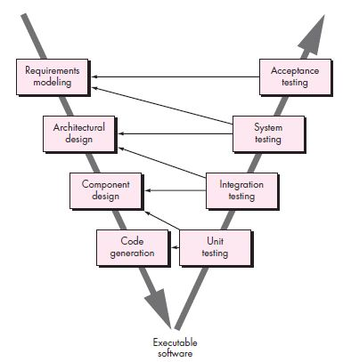
V-Model
Variation in the representation of the water model is called the V-model.

Slide 13
V-Model
The V-model depicts the relationship of quality assurance actions to the actions associated with the communication, modeling and, early construction activities
Model detail and technical representation of the problem when team move down the left side of the V
Once the code has been generated, team move up the right side of V, performing series of test.

Slide 14
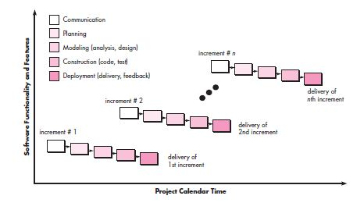
Incremental Model
Incremental Process Model

Slide 15
Incremental Model
Incremental model delivers a series of releases, called increments, that provide progressively more functionality for customer as each increment delivered.
The first increment is often a core product.
Basic requirement are addressed but many supplementary features remain undelivered

Slide 16
Incremental Model
When to use?
Useful when staffing unavailable for a complete implementation of project till deadline.
If the core product is well received, then additional staff (if required) can be added to implement the next increment.
When software engineering team are not very well skilled or trainee

Slide 17
Evolutionary Model
Evolutionary process model produce an increasingly more complete version of the software with each iteration.

Slide 18
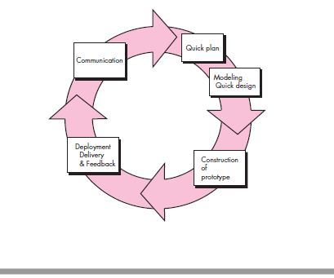
Evolutionary Model
Prototyping Model

Slide 19
Prototyping
When to use?
Customer defines a set of general objectives for software, but does not identify detailed requirements for functions and features
Developer may be unsure of the efficiency of an algorithm, the adaptability of an operating system

Slide 20
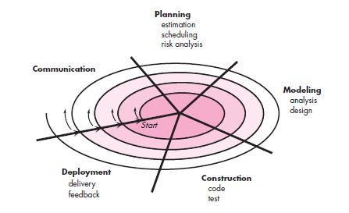
Evolutionary model
Spiral model

Slide 21
Spiral Model
The spiral model is a risk-driven process model.
Software is developed in series of evolutionary releases
During early iteration, release might be a model or prototype.
Later iterations, increasingly complete versions of the product
The spiral model is the realistic approach to the development of large scale systems and software

Slide 22
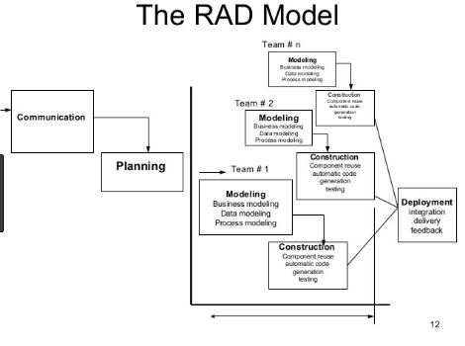
Rapid Application Development(RAD )

Slide 23
RAD
Multiple software team work in parallel on different functions
Modeling encompasses three major phases: Business Modeling, Date, Data modeling, Process Modeling
Construction uses reusable components, automatic code generation and testing

Slide 24
RAD
Problems in RAD
Required number of RAD teams
Not suited when technical teams are weak
Requires modularity

